Slide 1

Predicting Videos That Stay Trending A Closer Look At YouTube’s Frequently Trending Content
By Rohan Thampi

Slide 2
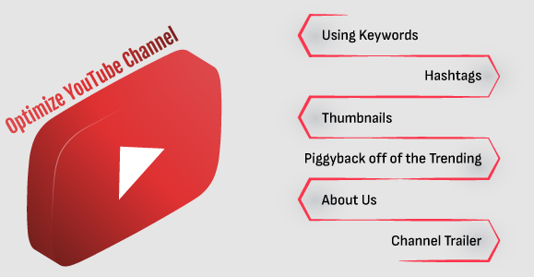
Background
YouTube updates its trending list every 15 minutes.
Trending may be dependent on many factors - number of views, age of video, etc.
Better understanding of key contributing factors could bolster the success of a video (i.e. make it frequently trend).
Source dataset: Trending YouTube Video Statistics - https://www.kaggle.com/datasets/datasnaek/youtube-new/data

Slide 3


Objective
Methodology
Using different modelling techniques to find the best classifier model with the most accurate prediction of if a video will trend once or repetitively
Data analysis
Data cleaning
Data wrangling
Data exploration
Modelling
Preprocessing
Creating the model
Evaluating
Hyperparameter testing

Slide 4
What the data looks like
JSON files for each country – chose US and Canada – 80k records
16 features, of which key may be –
views
likes
dislikes
comment_count
Feature | Data type
video_id | object
publish_datetime | datetime64[ns, UTC]
trending_date | datetime64[ns]
title | object
channel_title | object
category | object
category_id | int64
country | object
description | object
publish_date | datetime64[ns]
publish_time | object
views | int64
likes | int64
dislikes | int64
comment_count | int64
tags | object
comments_disabled | bool
ratings_disabled | bool

Slide 5
Data cleaning and wrangling
Removed records with “Deleted video” or which were flagged in variable video_error_or_removed
Replaced missing values with blank (for description variable)
Derived new features –
Number of tags
Number of repeats
Trending category (One-time/Repeat)
Age of video (time from publish to trending)
Comments/Ratings flag – enabled/disabled

Slide 6
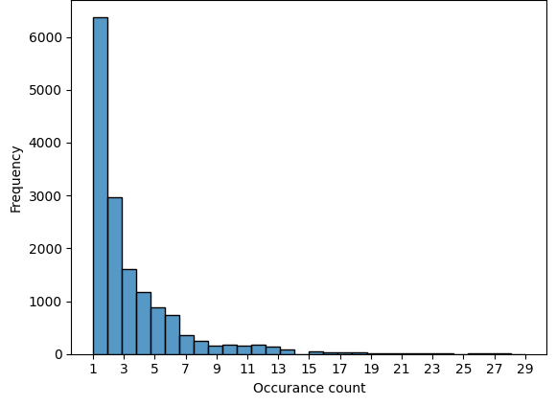
Data exploration and visualization
Bar plot of number of occurrences of a trending video
Based on this bar plot, current classification (i.e. one-time vs repeatedly trending) could be further subclassified into:
Common repeats (1-2)
Rare repeats (3-7)
Epic repeats (8-15)
Legendary repeats (>15)

Slide 7
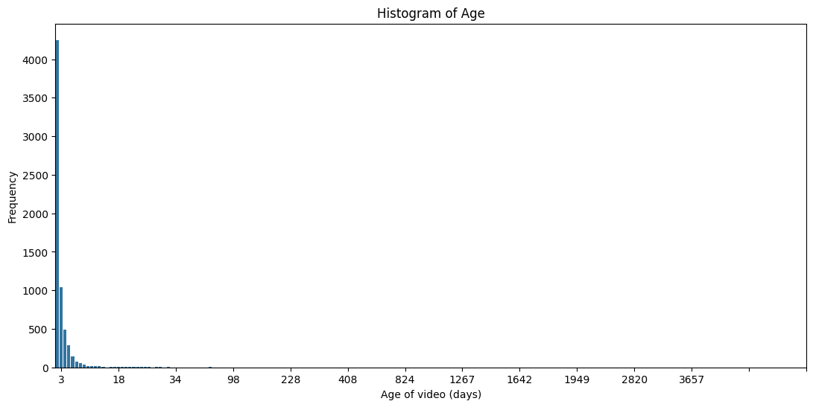
Data exploration and visualization
Bar plot of “age” of a trending video
Most of the data has age<=1 (~78% of data). This histogram excludes those, and shows that most others still trend within 10 days of upload, with 100s up to 35 days, with outliers up to 1000s of days

Slide 8
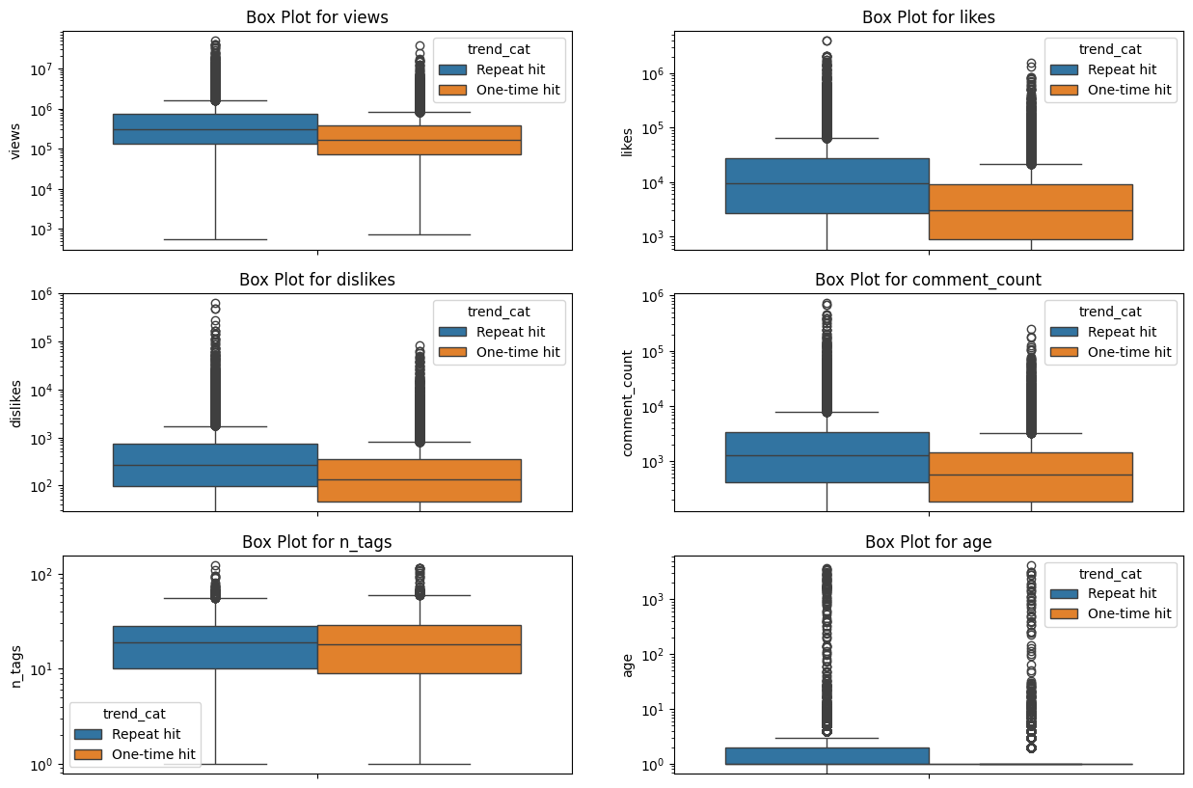
Data exploration and visualization
Distribution of features per trending category
These show that view, likes, dislikes, and comment count likely plays a significant factor.
Number of tags appeared to be surprisingly similar for both groups.
Box plots for Age seemed different, but their median are almost identical, making this likely an ineffective contributing factor.

Slide 9
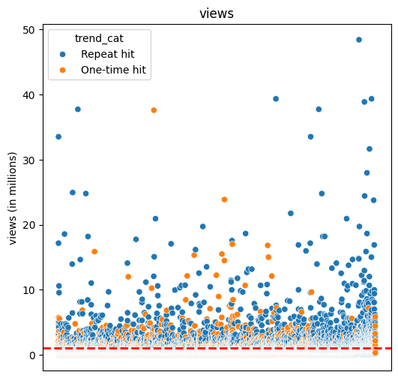
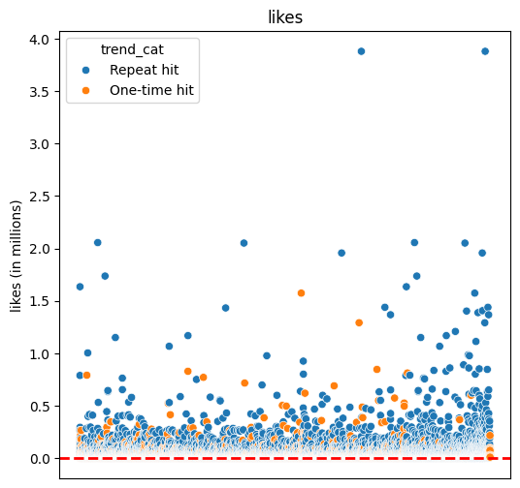
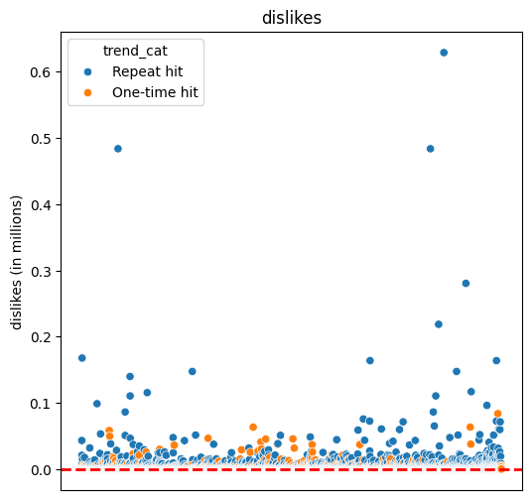
Data exploration and visualization
Testing for outliers
Red dotted line denotes the 95-percentile mark in data. Outliers in these metrics can contribute significantly to help classify it, and it is only a few fold higher than the rest. Thus the outliers are retained.

Slide 10
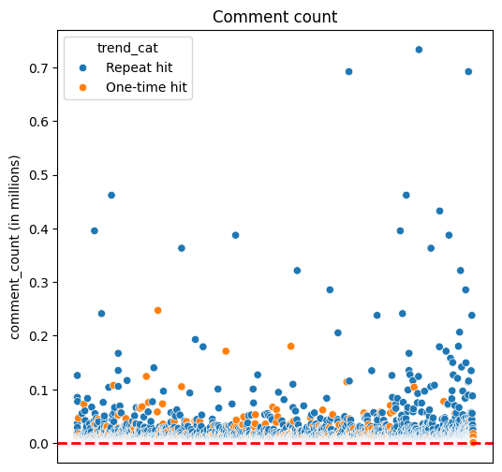
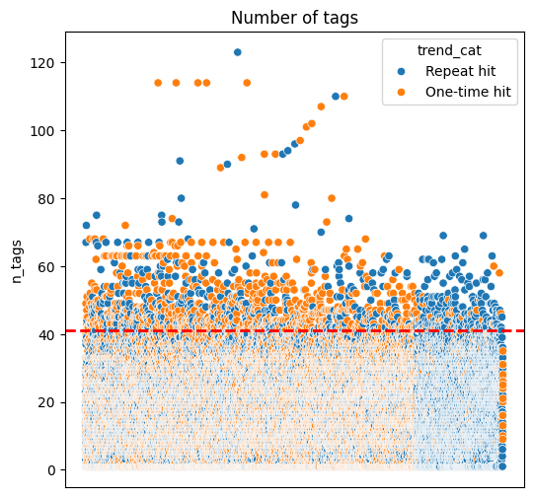
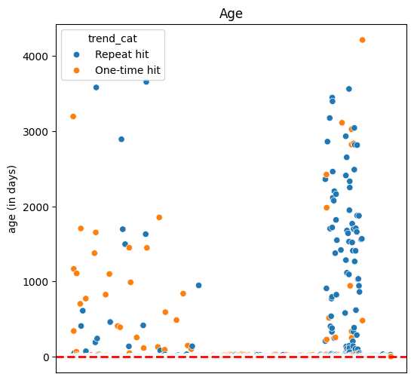
Data exploration and visualization
Testing for outliers
Red dotted line denotes the 95-percentile mark in data. Outliers in these metrics can contribute significantly to help classify it, and it is only a few fold higher than the rest. Thus the outliers are retained.

Slide 11
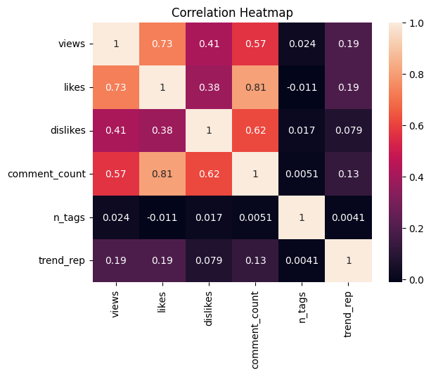
Data exploration and visualization
Correlation between features
Strong corr = Likes vs. Comment count & Views
Moderate corr = Views vs. Dislikes & Comment count, Likes vs. Dislikes
Minimal corr = Number of tags & Trending repeats

Slide 12

Modelling – Supervised Learning

Slide 13
Predicted variable & features used
Predicted/dependent variable - trend_cat (one-time / repeat)
Numeric features (scaled using StandardScaler) –
views
likes
dislikes
age
n_tags
comment_count
Categorical features (encoded using OneHotEncoding) –
category (Comedy/ Education/ Entertainment/ Film & Animation/ Gaming/…)
comments_status (enabled/disabled)
ratings_status (enabled/disabled)

Slide 14
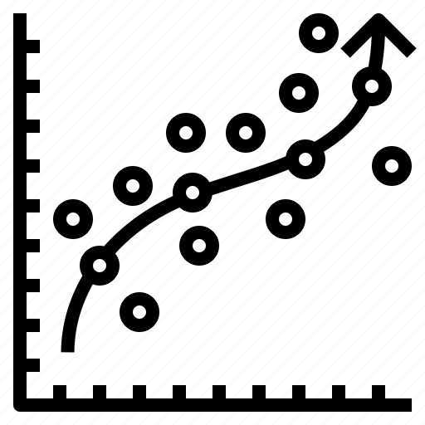
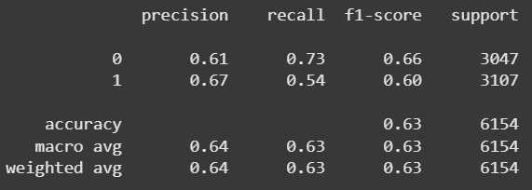

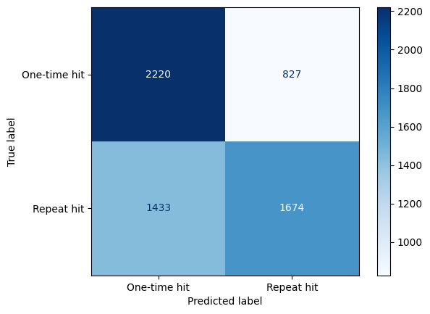
Logistic regression
Rationale for use: Binary classifier
Hyperparameter testing:
Best score – 62.9%
Best hyperparameters -
'C': 10, 'max_iter': 50
Classification report
Confusion matrix
Notes:
C: float, default=1.0 Inverse of regularization strength - A high value of C tells the model to give high weight to the training data, and a lower weight to the complexity penalty. A low value tells the model to give more weight to this complexity penalty at the expense of fitting to the training data.

Slide 15

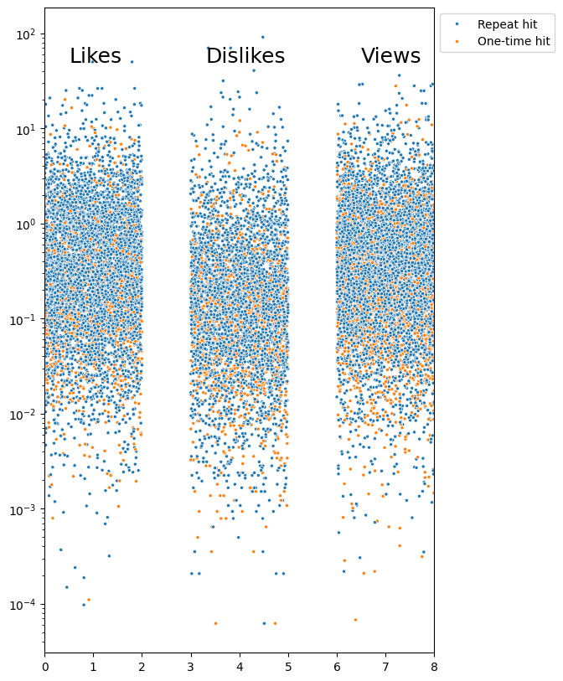
SVM
SVM is discarded as a potential solution as this problem cannot be solved with a linear solution since the 2 categorical data are highly interspersed (i.e. non-linear data).
Notes:
C: float, default=1.0 Inverse of regularization strength - A high value of C tells the model to give high weight to the training data, and a lower weight to the complexity penalty. A low value tells the model to give more weight to this complexity penalty at the expense of fitting to the training data.

Slide 16
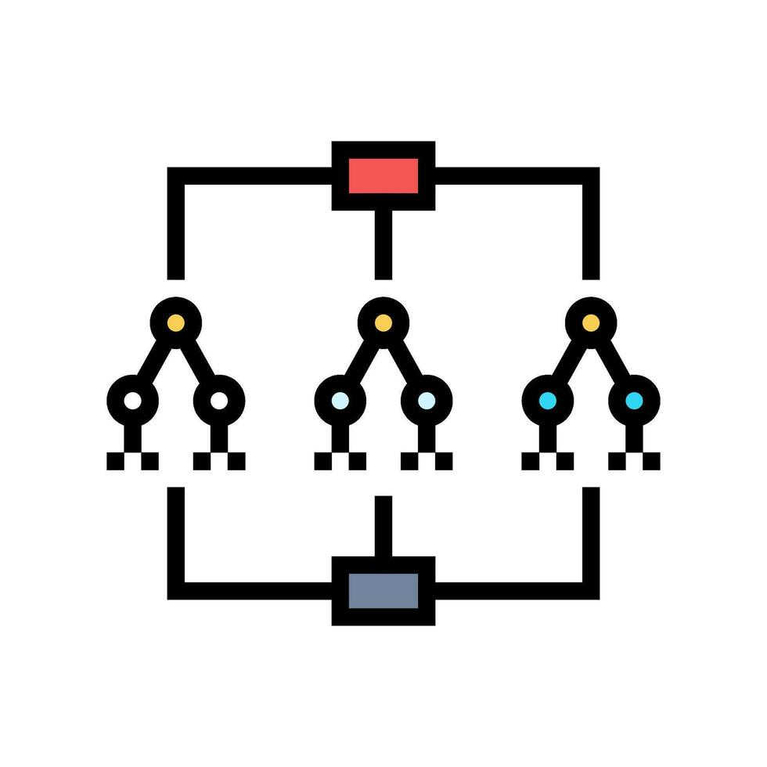
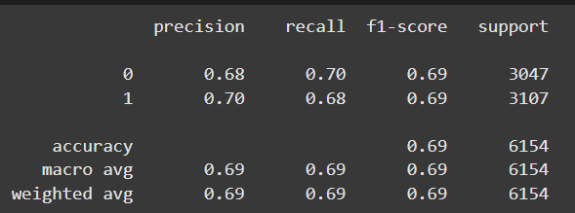
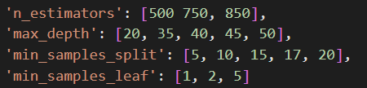
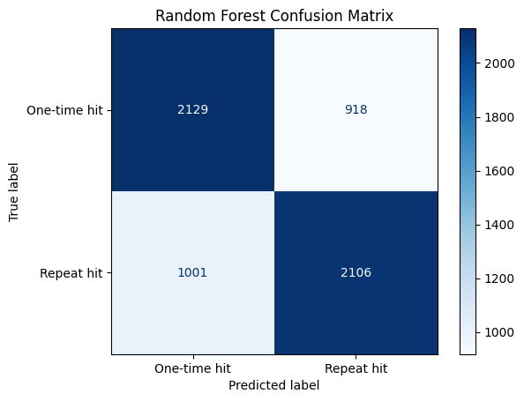
Random Forest
Rationale for use: Higher number of features
Base model score – 68.2%
Hyperparameter testing:
Best score – 68.43%
Best hyperparameters :
'max_depth': 40
'min_samples_leaf': 2
'min_samples_split': 20
'n_estimators': 850
Classification report
Confusion matrix

Slide 17
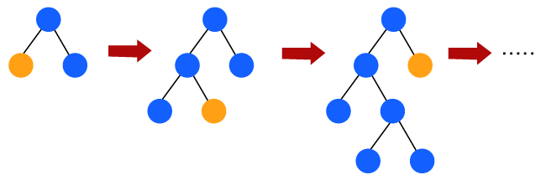
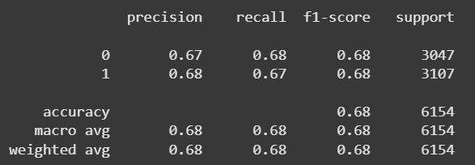
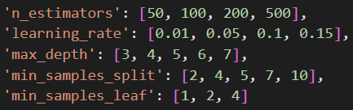
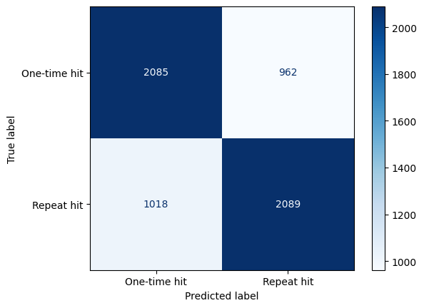
Gradient Boosting
Rationale for use: Good for larger datasets
Base model score – 67%
Hyperparameter testing:
Best score – 67.46%
Best hyperparameters :
'learning_rate': 0.05
'max_depth’: 7
'min_samples_leaf’: 1
'min_samples_split’: 7
'n_estimators': 200
Classification report
Confusion matrix

Slide 18

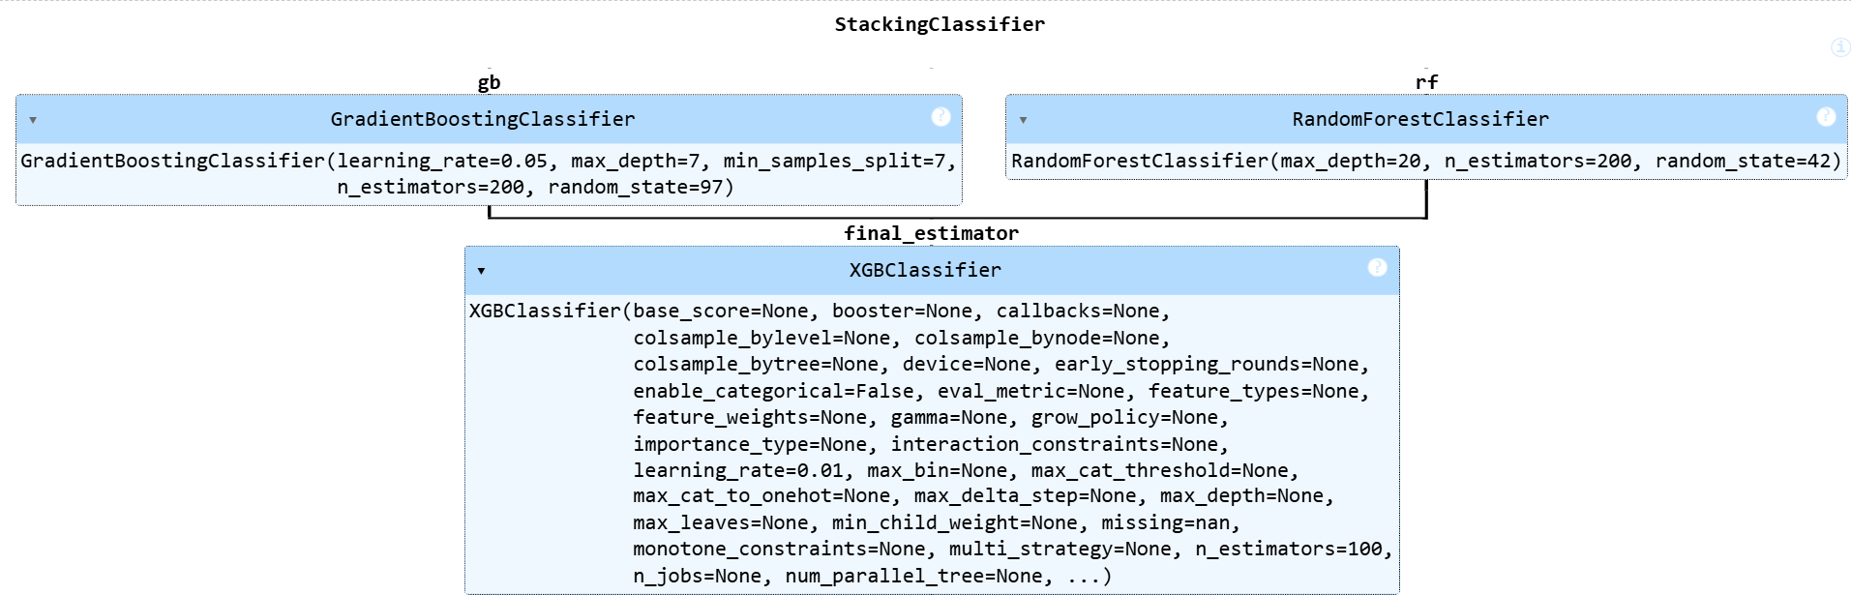
Stacked model (Gradient Boosting + Random Forest)

Slide 19
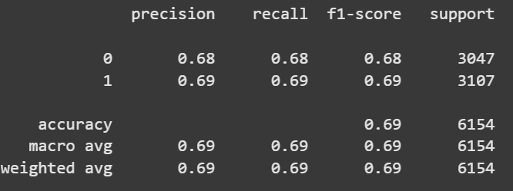
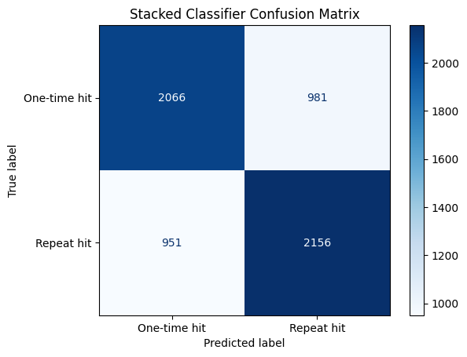
Stacked model (Gradient Boosting + Random Forest)
RF model: 68.8%
GB model: 67.8%
Stacking Ensemble Accuracy: 68.93%
Classification report
Confusion matrix

Slide 20


Conclusion
Random Forest, Gradient Boosting and their Stacked model (RF+GB) performed the best.
But the stacked model does not significantly boost the accuracy to justify its complexity.
Thus we choose Random Forest to be our best model for the data!
Stacked model
68.9%
Random Forest
68.43%
Gradient boosting
67.46%
Logistic regression 62.9%
SVM

Slide 21
Scope for future work
Use of more data – more countries, larger periods of time
Feature selection for better accuracy
Use NLP on title, description, comments to understand if they may be contributing features
Multi-classifier model
Common repeats (1-2)
Rare repeats (3-7)
Epic repeats (8-15)
Legendary repeats (>15)

